Slide 1



Build and Evaluate
RAG Systems
Presented by:
Niharika Shrivastava
Data Scientist | MS @ NUS Singapore

Slide 2
Setup
Link to colab notebook: https://shorturl.at/nA56J
Mix of concepts + coding

Slide 3
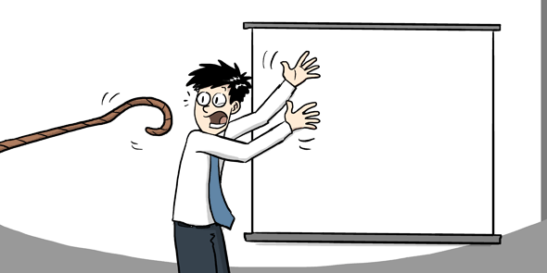
Talk Outline
Difference b/w RAG and Fine-Tuning
RAG Architecture:
Basic
Advanced
Ways to evaluate RAG
LLM as a judge
Conclusion

Slide 4
What is RAG?
Retrieval Augmented Generation
(retrieves additional context from an external knowledge base relevant to the user query)
Query
LLM (query+context)
Answer

Slide 5
RAG
Fine-Tuning
Ability to frequently update data sources without retraining.
Incorporating new data means retraining the LLM.
Reduces hallucination by grounding outputs.
Reduces hallucinations by learning domain-specific data.
Retrieval steps add inference latency.
Inference is faster.

Slide 6
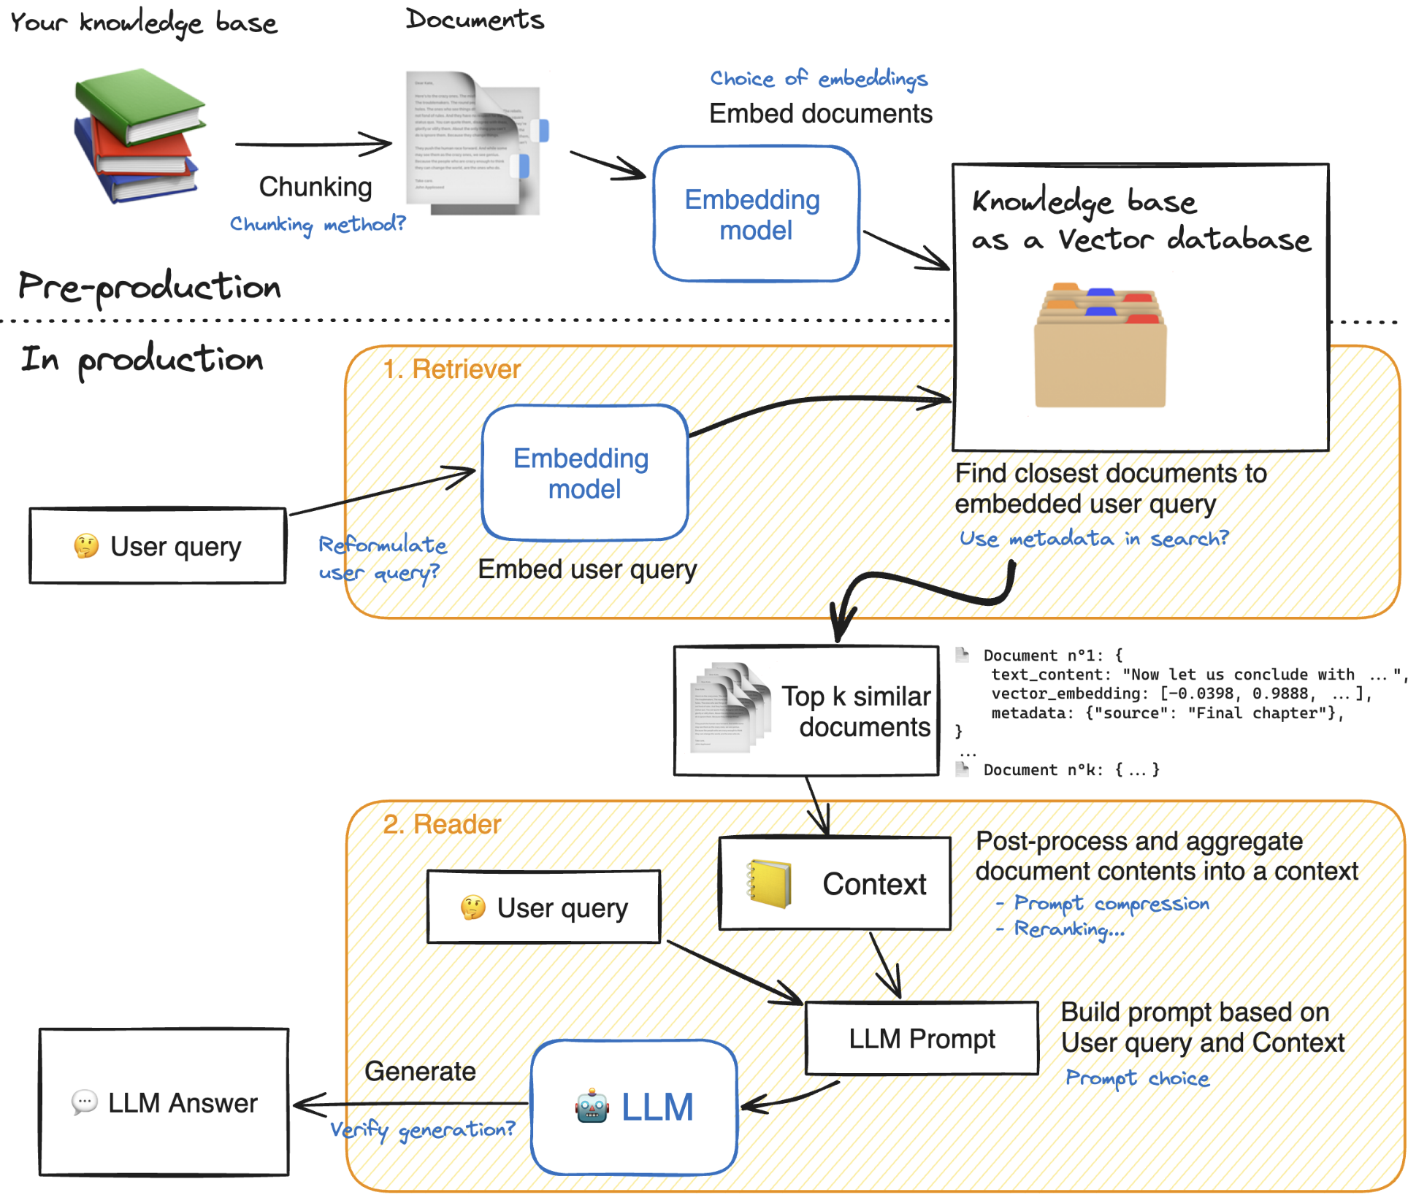
RAG Architecture: Basic

Slide 7
RAG Architecture: Advanced
Enhancements
Basic Setup

Slide 8
Ways to Evaluate RAG
Humans
Traditional NLP scores
Another LLM
Time consuming.
Prone to biases.
Precision (Bleu)
Recall (Rouge)
Broad capabilities
Varied preferences

Slide 9
Use LLM as a judge
Create an evaluation set
(QA pairs)
Generate answers using RAG on evaluation set
Evaluate answers using another LLM
gemini-1.5-flash-001
gemini-1.0-pro
gemini-1.5-flash-001

Slide 10
Build a Synthetic Evaluation Set
Sample contexts from knowledge base
Generate QA pairs using contexts
Filter out quality QA pairs
Contexts are equally sized chunks of documents.
May contain text + metadata.
Possible questions from the context asked by a user.
Generate answer to the question supported by the context.
Using gemini-1.5-flash-001 LLM to generate QA pairs.
Generate at least > 200 QA pairs since some will get filtered.
Use the same LLM to rate each generated question from 1-5.
Criterias:
Groundedness
Relevance
Stand-alone
Remove all questions with scores < 4 for any criteria.

Slide 11
Build a RAG System
Split docs using recursive split
Embed docs
Build retriever
Overlapping chunks
Model used: thenlper/gte-small
Use FAISS index as a vector database and quick retriever of similar chunks
Formulate answer using (query + contexts)
Rerank retrieved contexts
LLM used: gemini-1.0-pro
(different from eval)
Rerank based on their relevance to the query and output top-K.
Model used: colbert-ir/colbertv2.0

Slide 12
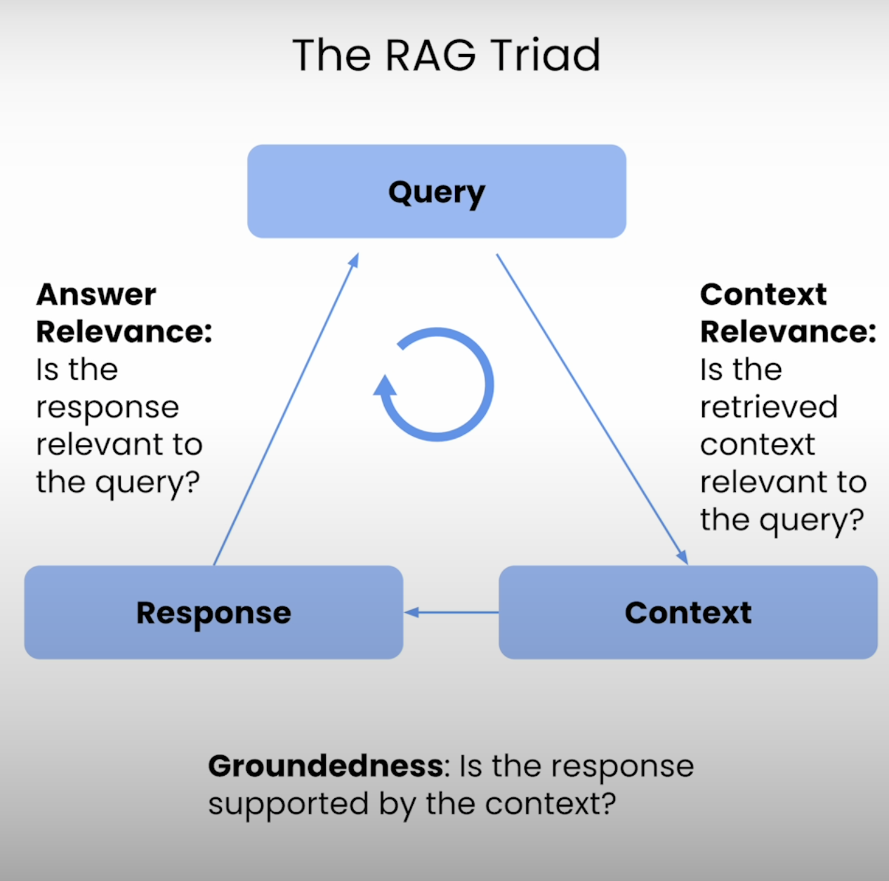
Use LLM-as-a-judge
Use another LLM to critic the responses of our RAG system.
LLM used: gemini-1.5-flash-001
Use a scoring rubric to ground the evaluation (1-5).
Evaluation metrics:
Answer correctness
Context relevance
Groundedness (faithfulness)

Slide 13
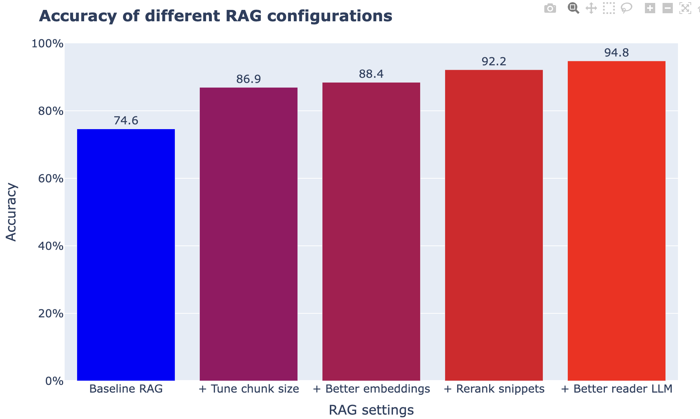
Use LLM-as-a-judge

Slide 14
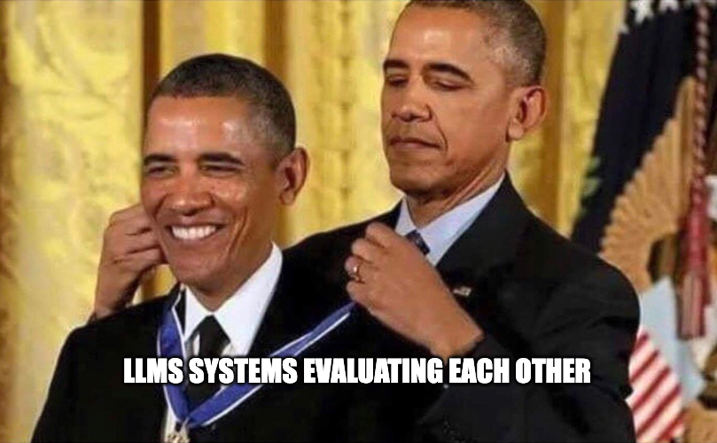
aaaand Thank You! :D

Slide 15
References
ChatVertexAI | 🦜️🔗 LangChain
Vertex AI Jupyter Notebook tutorials | Google Cloud
Metrics | Ragas
Simple RAG for GitHub issues using Hugging Face Zephyr and LangChain - Hugging Face Open-Source AI Cookbook
⟁ RAG Triad - 🦑 TruLens
Rerankers and Two-Stage Retrieval | Pinecone
Paper page - Judging LLM-as-a-judge with MT-Bench and Chatbot Arena

